Slide 1
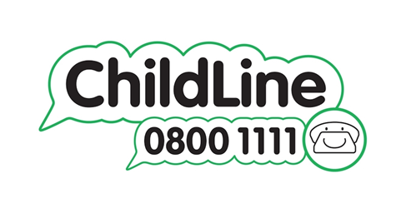
Sexual Health
If you are in a relationship an having sex, it is important to look after your sexual health
Childline have information on contraception and safe sex Contraception and safe sex | Childline as well as information about sexual transmitted infections Sexually transmitted infections | Childline
Young Greenwich and METRO offer sexual health support for young people between 13 and 24, including:
A Youth Line, Mondays – Friday, 0208 305001
1:1 video call, phone call or face-to-face session with a Sexual Health worker
Sexual Health Workshops
Young Greenwich C-Card Scheme, where you can get free condoms.
Chlamydia screening kits
Health - Young Greenwich Youth Services (young-greenwich.org.uk)

