Slide 1
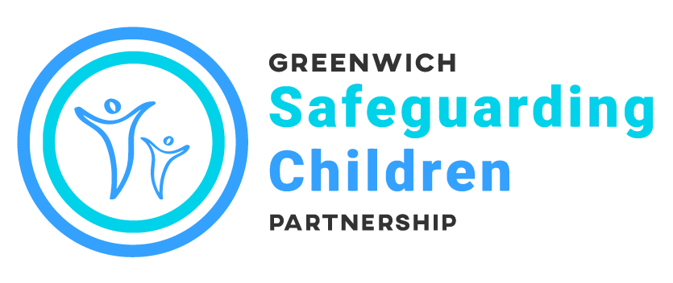
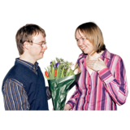
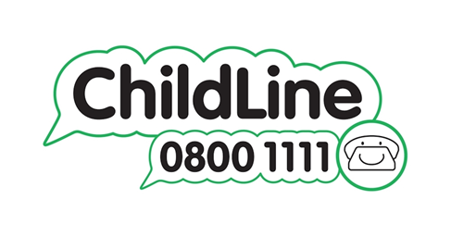
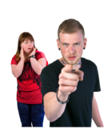
Relationships
As you get older you may find that you have special relationships with others, usually involving romantic or sexual feelings.
Childline have information on relationships
Relationships | Childline
If your relationship leaves you feeling scared, intimidated or controlled, you could be in an abusive relationship.
The Children’s Society has information on the signs of an abusive relationship, helplines and resources Teenage Relationship Abuse | The Children's Society (childrenssociety.org.uk)

