Slide 1
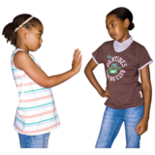
Friendships
As you grow up you will make new friends.
We talk to friends, have fun with them and they can help with problems.
BBC Bitesize has information on making friends here: Developing friendships - BBC Bitesize
Sometimes you might have arguments or fall out with your friends.
Childline has information about what you can do if you fall out with a friend.
Friends | Childline

