Slide 1
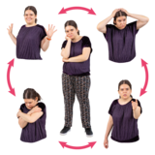
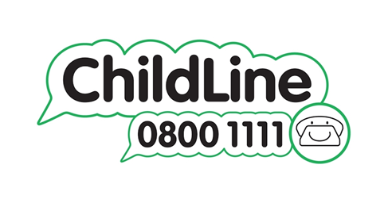
Feelings, Emotional
wellbeing and mental health
Everyone has feelings.
Some feelings are happy, sad, angry, confused and excited.
Sometimes feelings can become too big or out of control.
Childline has information and advice about different feelings
Feelings and emotions | Childline
Young Minds has information about different feelings, how to cope with them and where to go for help
Help With How I'm Feeling | Mental Health Advice | YoungMinds | YoungMinds

Slide 2
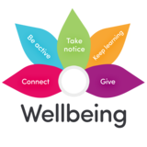
Feelings, Emotional
wellbeing and mental health
Emotional wellbeing is how we manage our feelings.
The Samaritans have information on Emotional Wellbeing
Young people | Emotional health resources | Mental health | Samaritans
The Children’s Society has tips, advice and activities around emotional wellbeing Well-Being Activities | The Children's Society (childrenssociety.org.uk)

Slide 3
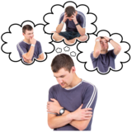
Feelings, Emotional
wellbeing and mental health
Mental health is how we feel, think and act.
Childline has information and advice about feelings
Feelings and emotions | Childline
Young Minds has information about feelings, how to cope with them and where to go for help
Help With How I'm Feeling | Mental Health Advice | YoungMinds | YoungMinds

