Slide 1
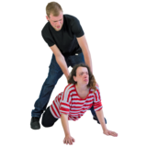
Domestic Abuse
Domestic Abuse is an adult being volent, threatening violence, bullying or hurting another adult in their family or the person they are in a relationship with.
Women’s Aid have created a space to learn more about domestic abuse and what to do if it is happening to you The Hide Out
Childline has information about domestic abuse Domestic abuse | Childline
The Children’s Society has information about domestic abuse What Is Domestic Abuse? | The Children's Society (childrenssociety.org.uk)

