Slide 1
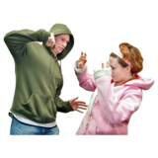
Crime, Violence,
Gangs and Exploitation
A crime is a deliberate act that causes harm, damage to or loss of property, and is against the law.
Fearless has information on different types of crime and services that can support if you have been a victim of crime
Home - Fearless
Violence is behaviour involving physical force intended to hurt or damage someone or something.
Voice has information and advice on attacks, abuse and violence
Attacks, abuse and violence - 11-15 | Voice for Children & Young People (voicenorthants.org)

Slide 2
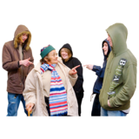
Crime, Violence,
Gangs and Exploitation
A gang may be a group of friends that hang out together.
But a gang can also be an organised group of criminals.
Childline has more information about gangs and the law, leaving a gang and how you can help if you think someone you know is part of a gang.
Gangs | Childline
Sometimes, gangs will entice, trick or pressure young people to become part of their gang and carry out crime for them.
This is called exploitation.
The NSPCC have information, advice and support around exploitation
Criminal exploitation and gangs | NSPCC

