Slide 1
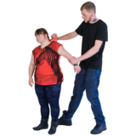
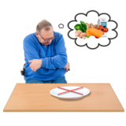
Child Abuse
Child Abuse is when a child or young person is harmed by an adult or another child.
There are different types of abuse.
Neglect
This is when a parent or carer doesn’t provide the things someone needs, like food, drink, clothes or protection from danger.
Physical Abuse
This is when someone hurts a child or young person with their hands, their feet, other parts of their body or an object.

Slide 2
Child Abuse
Emotional abuse
This is when someone tries to control a child or young person by using words and emotions.
Sexual Abuse
Sexual abuse is when a child or young person is forced, pressurised or tricked into taking part in sexual activity.
If this is happening to you, you could talk to a trusted adult.
If you can’t talk to an adult, call Childline on 0800 1111.

