Slide 1
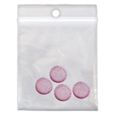
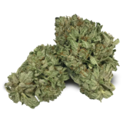
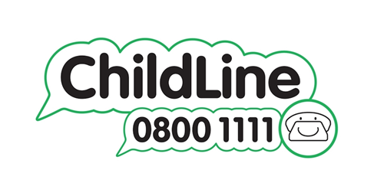
Alcohol and Drugs
It is important to know the facts about alcohol and drugs, including the dangers and where to get help.
The Mix has information on what alcohol does to your brain and your body
What Drink Does To Your Body | What Drink Does To Your Brain | The Mix
Childline has information about alcohol and drugs
Drugs, alcohol and smoking | Childline
Young Minds provides information on the law around alcohol and drugs,, how you can tell if you have a problem with alcohol or drugs and where to get help
Drugs and Alcohol | Support For Young People | YoungMinds

